Slide 1
OO Design Patterns
Coding Cleverly
Notes:
1

Slide 2
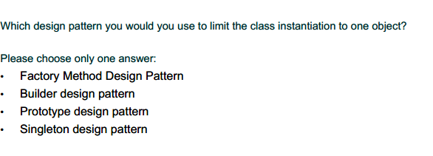
Warm UP
Notes:
2

Slide 3
Warm UP
Notes:
3

Slide 4
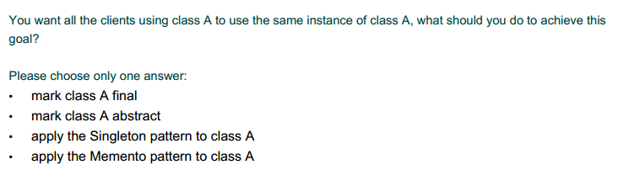
Warm UP
Notes:
4

Slide 5
Warm UP
Notes:
5

Slide 6
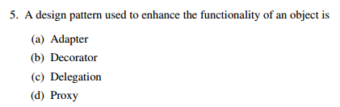
Warm UP
Notes:
6

Slide 7
Warm UP
Notes:
7

Slide 8
Concept
What is the difference between architecture and design?
Notes:
8

Slide 9
Concept
What is the difference between architecture and design?
Architectural styles: Broad approaches to solving problems (pipes & filters, object-oriented, tiers, repository, etc.) that define which underlying tools are available to be used by patterns. These must be decided early, as they provide the general approach that is implemented.
Basic design patterns: Refer to how the internals of a component are arranged in order to solve problems. These are decided on as the problem they solve arises. e.g. An iterator is introduced when an operation must be applied to every component of a data structure.
Design patterns specify a general solution schema for problems that is known to have certain desirable properties.
Notes:
9

Slide 10
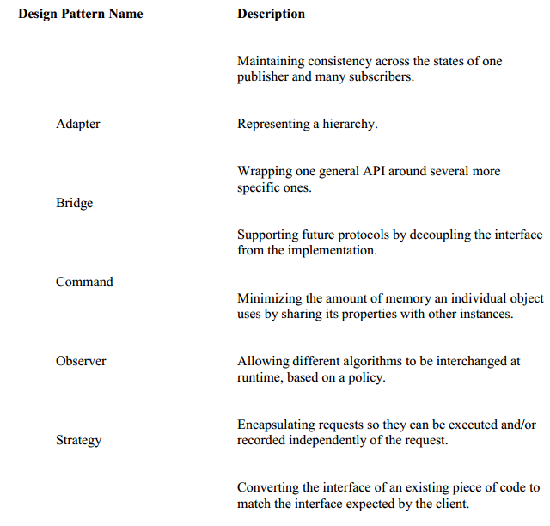
Matching
Notes:
10

Slide 11
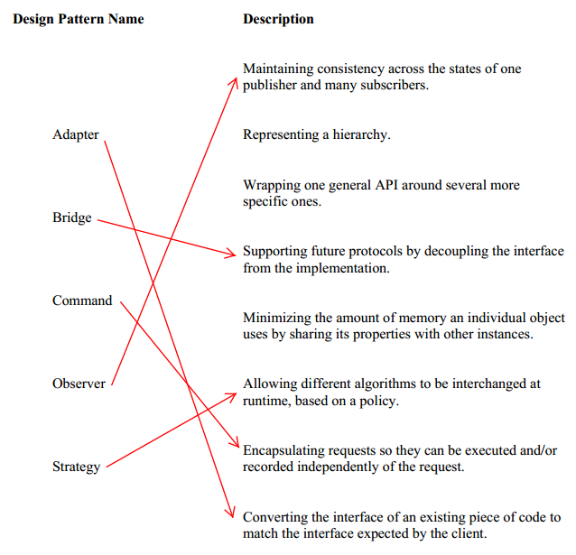
Matching
Notes:
11

Slide 12
Case Study
ParkingMontreal.com is a new system to track the availability of parking spots around the city of Montreal. This system will provide services both to the public, by helping them find nearby available parking spots, and to the City of Montreal parking attendants, by helping them locate parked cars whose meters have expired. Users who are registered with ParkingMontreal.com can also pay for their parking spot using their cellular phone. And, of course, the general public still has the option to pay for parking using the existing kiosk-based system.
Notes:
12

Slide 13
References
http://www.tutorialspoint.com/design_pattern/design_pattern_overview.htm
Factory: https://www.youtube.com/watch?v=ub0DXaeV6hA
http://s3.amazonaws.com/docuum/attachments/2139/Old%20final%20winter%202008.pdf?1240434717
https://cs.uwaterloo.ca/~a78khan/cs446/additional-material/scribe/99-exams/1005-Final_exam-Solutions.pdf

